Slide 1
Apply Procedures to Develop Menus, List Box and Combo Box Objects
Computer Programming I

Slide 2
Objective/Essential Standard
Essential Standard 6.00 Apply tools to obtain and validate user input.
Indicator 6.01 Apply procedures to develop menus, List Box and Combo Box objects (3%)

Slide 3
Adding a Menu

Slide 4
Why Add a Menu?
Adding a menu increases the interactivity of your application.
The menu allows the user to interface with your application.
What menus can be added to your application form?
In this course, we will add a MenuStrip to our form.

Slide 5
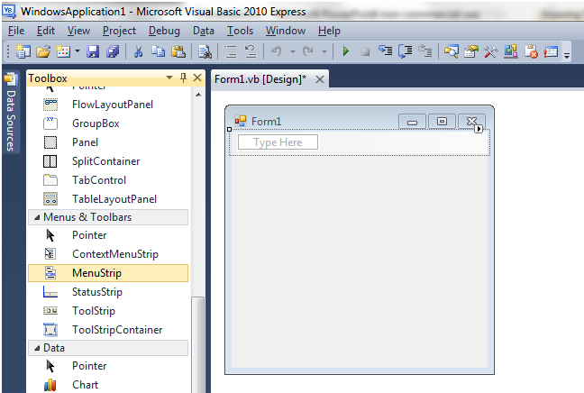
The MenuStrip Control
Adds a menu bar to your form
Use the prefix mnu when naming your menu
Example: mnuMain
Once you click the MenuStrip control, it doesn’t matter where you click on the form. It will automatically place the menu at the top.

Slide 6
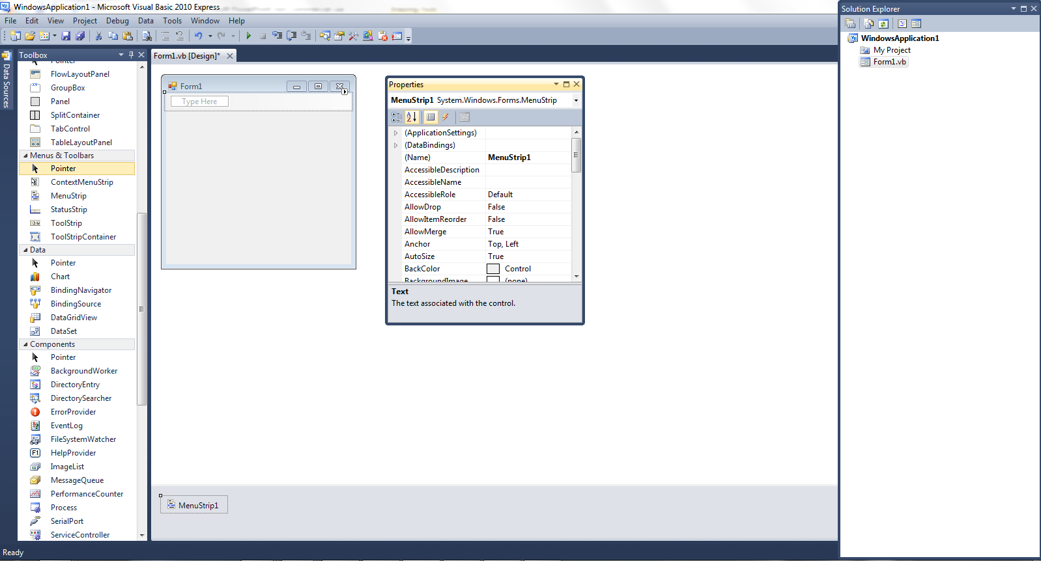
The MenuStrip Control
Note that when you add the MenuStrip, it puts an icon in the gray area at the bottom called the component tray.

Slide 7
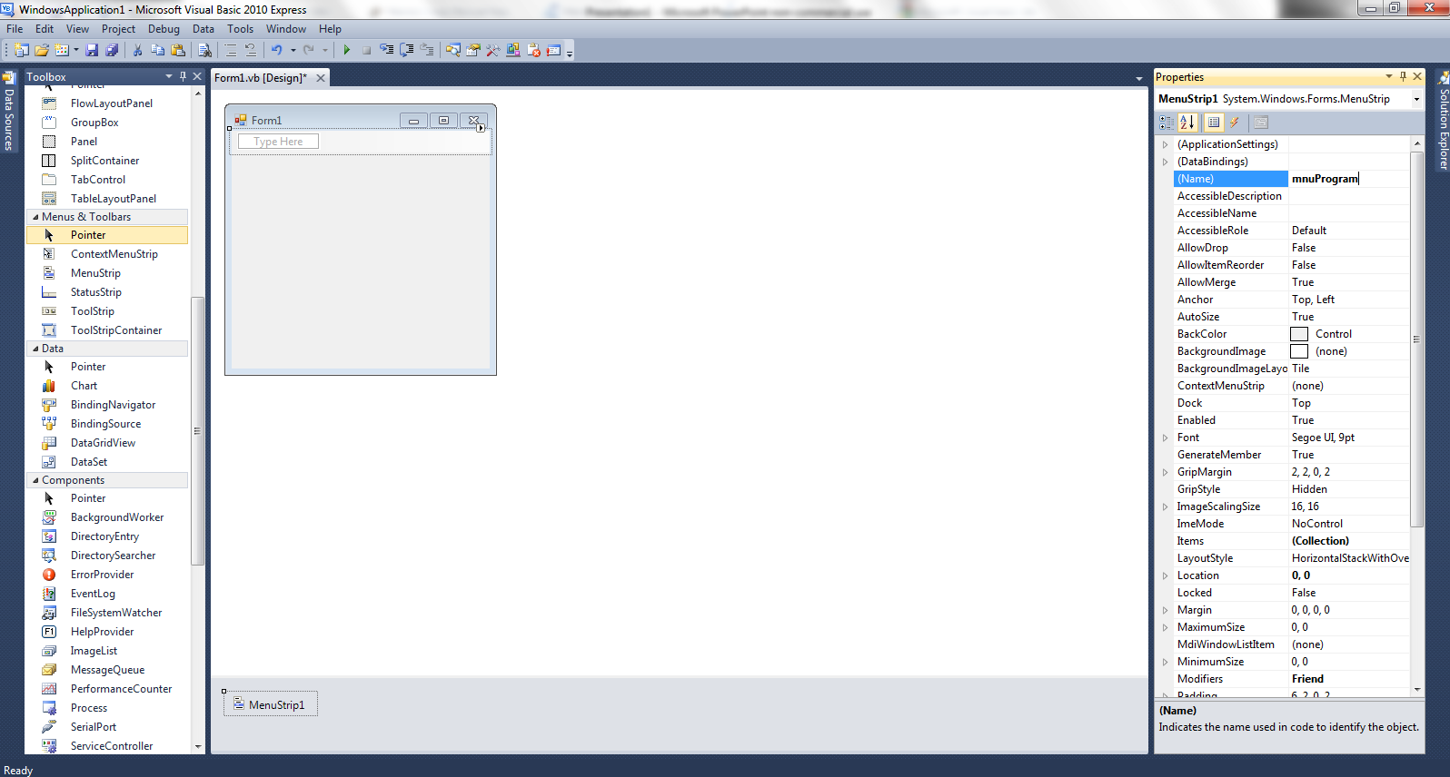
The MenuStrip Control
Select the MenuStrip control
Select the (Name) property to change the name
Use the prefix mnu

Slide 8
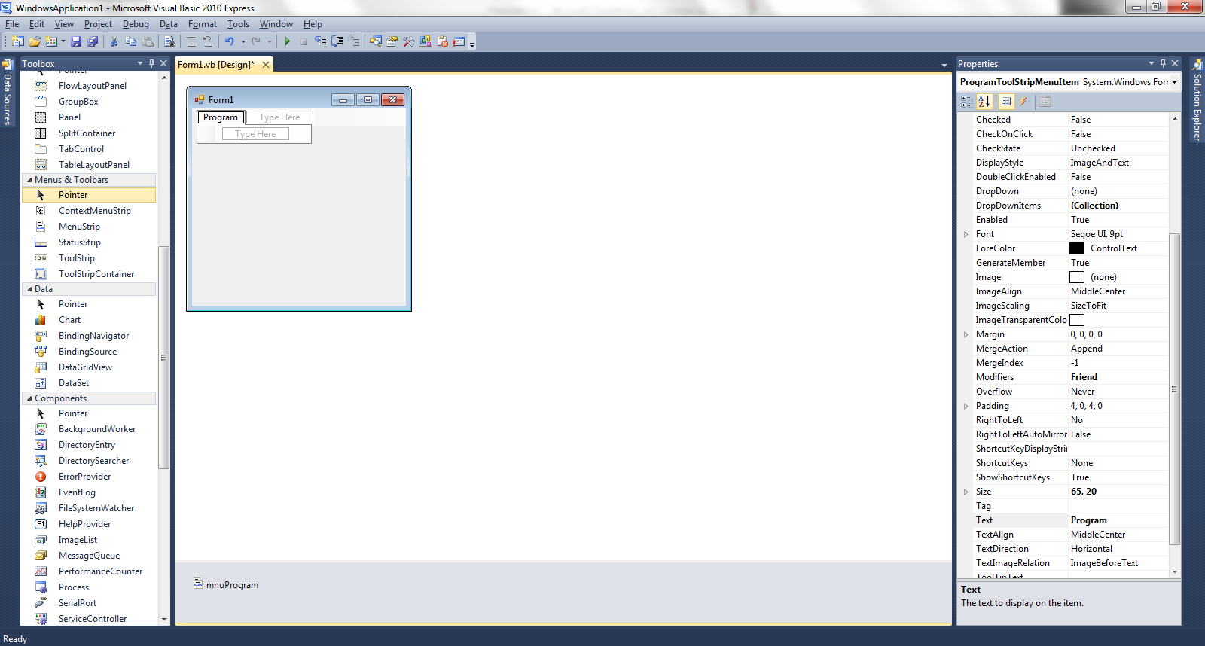
The MenuStrip Control
Click in the text area of the MenuStrip control, type “Program”.
Note this changes the text property and the name property of this menu entry in the Properties area.
You can add additional menu entries at the same level or add submenu items.

Slide 9
The MenuStrip Control
To add code to your menu item, go to your code view.
Right Click → View Code
View Menu → Code
F7
Double Click the Menu Item
In the Class Name List, select your menu object.
In the Method Name List, select the appropriate method.
In this case, we are selecting the Click event

Slide 10
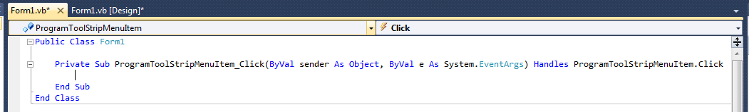
The MenuStrip Control
Type your code inside the Click event.
For example if you wanted the application to close when Program is selected, type the following: Application.Exit()
Note that an Autolist is provided as you type.

Slide 11
Form – Backcolor property
The form has a new property called Backcolor.
Backcolor – changes the color of the background of the form
Ex: BackColor = Color.Blue
The keywork Color. will generate a list of system colors to choose from.

Slide 12
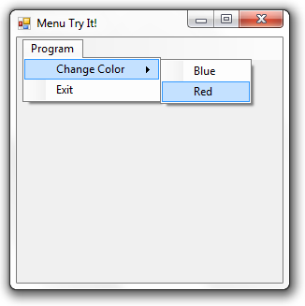
Try It!
Create a new application called menuExample.
Save it in the folder as directed by your teacher.
Add a MenuStrip control
Properties: Name: mnuMenu
Add an entry so that your form matches the image.
Properties: Name: mnuChgClr Name: mnuChgBlu Name: mnuChgRed Name: mnuExit

Slide 13
Try It! Solution – Visual Basic
Public Class Form1
Private Sub ExitToolStripMenuItem_Click(ByVal sender As System.Object, ByVal e As System.EventArgs) Handles ExitToolStripMenuItem.Click
Application.Exit()
End Sub
Private Sub BlueToolStripMenuItem_Click(ByVal sender As System.Object, ByVal e As System.EventArgs) Handles BlueToolStripMenuItem.Click
Me.BackColor = Color.Blue
End Sub
Private Sub RedToolStripMenuItem_Click(ByVal sender As System.Object, ByVal e As System.EventArgs) Handles RedToolStripMenuItem.Click
Me.BackColor = Color.Red
End Sub
End Class

Slide 14
ListBox & ComboBox

Slide 15
ListBox & ComboBox
List boxes and combo boxes increase the interactivity of your application giving choices to the user.
They allow the user to interface with your application.
In this presentation we will look at how to add these new control objects to your application.

Slide 16
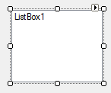
The ListBox Control
The ListBox displays a list from which the user can select one or more items.
If the list is longer than the list box, a scrollbar is automatically added.

Slide 17
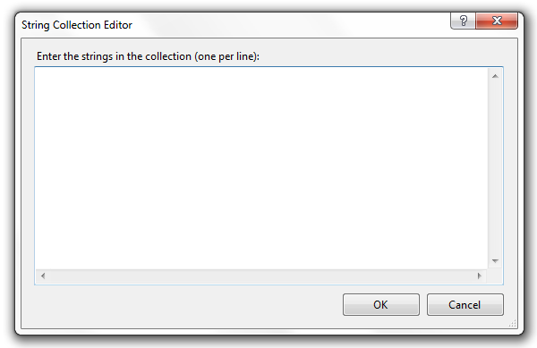
The ListBox Control Properties
(Name)
The name of a ListBox should start with the prefix lst (This is the lowercase letter L, not a number 1.)
Items
Click in this property where it displays (Collection). A new dialog box called the String Collection Editor will appear. Type your list box items here.
Be careful with your spelling.
Make sure you hit the Enter key after the last item.

Slide 18
The ListBox Control Properties
Text
The text property returns the actual string value of the item. The item selected when running is placed inside the text property.
Enabled
The enabled property is set to true by default. If this property is set to false, the list box is not available for the user.
Sorted
The sorted property is set to false by default. If this property is set to true, your collection of items will be sorted ascending.
Visible
The visible property is set to true by default. If this property is set to false, the list box is not visible to the user.

Slide 19

Using The ListBox Control - Runtime
SelectedIndex Property
This property allows the programmer to compare what the user has selected in the list box with a value.
The first item in the list box is at index position 0. If the user selects the first item in the list box, the SelectedIndex value will be 0, if the second item is selected, the SelectedIndex value is 1.
If no item is selected, the SelectedIndex value is -1.
This property is only available at runtime.
Item | SelectedIndex Value
First | 0
Second | 1
Third | 2

Slide 20
Using The ListBox Control - Runtime
SelectedItem Property
This property allows the programmer to compare what the user has selected in the list box with the item itself as a string value.
The comparison is exact, so your spelling, capitalization, and spacing matters.
This property is only available at runtime.
Item | SelectedItem Value
First | Chocolate
Second | Strawberry
Third | Vanilla

Slide 21
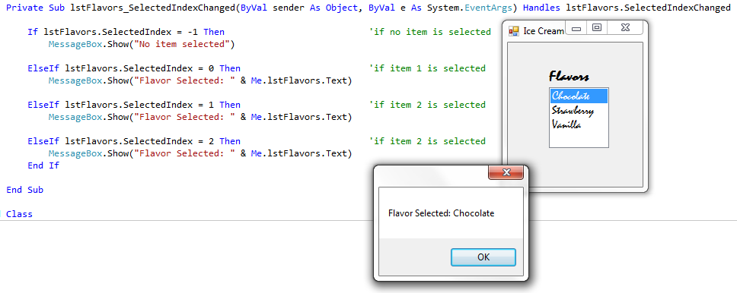
Using The ListBox Control
ListBox.SelectedIndexChanged & SelectedIndex
You will use a SelectedIndexChanged event to compare either index values or the item to determine the list box item selected.
3

Slide 22
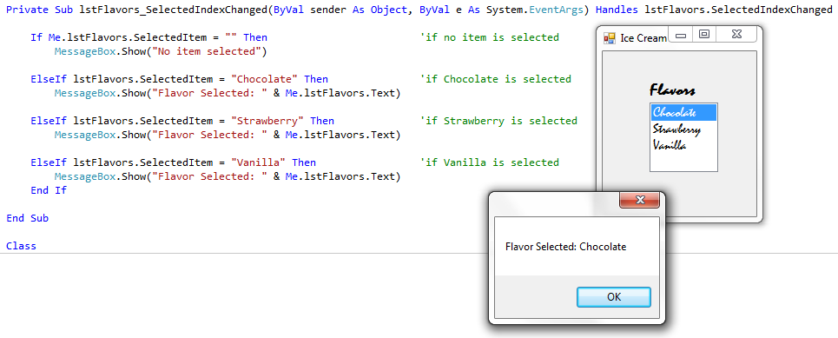
Using The ListBox Control
ListBox.SelectedIndexChanged & SelectedItem
You will use a SelectedIndexChanged event to compare either index values or the item to determine the list box item selected.
Your string must match the item exactly that is typed in the Collection.

Slide 23
Runtime Commands - ListBox Control
During runtime, you can add, delete and clear all items from a ListBox using Items.Add, Items.Remove and Items.Clear. Me.lstFlavors.Items.Add(“Cherry”) ‘Adds Cherry to the lstFlavors collection Me.lstFlavors.Items.Remove(“Vanilla”) ‘Removes Vanilla from the lstFlavors collection Me.lstFlavors.Items.Clear() ‘Clears the entire list.

Slide 24
ListBox & ComboBox SelectedIndexChanged
Just like you create a TextChanged event for a TextBox, you can create a SelectedIndexChanged event for a ListBox or ComboBox.
You can use this event to clear the answer from a label. Private Sub lstChoice_SelectedIndexChanged(ByVal sender As Object, ByVal e As System.EventArgs) Handles lstChoice.SelectedIndexChanged
Me.lblResult.Text = Nothing ’Clears Label
End Sub

Slide 25
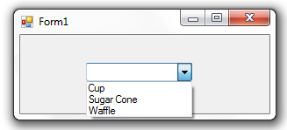
The ComboBox Control
The ComboBox displays a list in a drop-down box.
It is actually a combination of a textbox and a listbox.
The top of the ComboBox allows the user to type input.
The second part of the ComboBox displays a list of items from which the user can select.
Textbox
Listbox

Slide 26
The ComboBox Control Properties
(Name)
The name of a ComboBox should start with the prefix cbo
Items
Click in this property where it displays (Collection). A new dialog box called the String Collection Editor will appear. Type your items here.
Be careful with your spelling.
Make sure you hit the Enter key after the last item.

Slide 27
The ComboBox Control Properties
Text
The text property returns the actual string value of the item.
Enabled
The enabled property is set to true by default. If this property is set to false, the list box is not available for the user.
Sorted
The sorted property is set to false by default. If this property is set to true, your collection of items will be sorted ascending.
Visible
The visible property is set to true by default. If this property is set to false, the list box is not visible to the user.

Slide 28
Using ComboBox Control –Visual Studios 2010
Whether a value was keyed or an item selected, the text property will hold the value.
Example:
MessageBox.Show(Me.cboComboBox.Text)
’value typed or item selected is shown.

Slide 29
Using The ComboBox Control
Prior to Visual Studios 2010, an If…Then…Else statement was needed to determine if a value was entered or an item selected. 2010 users can use the text property as shown in the previous example.
Example:
If Me.cboComboBox.SelectedIndex >= 0 Then
MessageBox.Show(Me.cboComboBox.SelectedItem) ’item selected
Else
MessageBox.Show(Me.cboComboBox.Text)
’value typed
End If

Slide 30
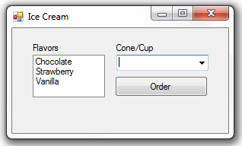
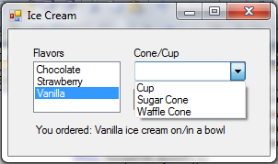
Try It!
Create a new application called iceCreamExample
Save it into the location as instructed by your teacher.
Add the following controls.
When the button Order is clicked, the order should be displayed in the lblOrder label.
Control | Name | Text/Items
Label | lblFlavors | Flavors
ListBox | lstFlavors | Chocolate Strawberry Vanilla
Label | lblCone | Cone/Cup
ComboBox | cboCome | Cup Sugar Cone Waffle Cone
Label | lblOrder | Empty

Slide 31
Try It! Solution
Private Sub btnOrder_Click(ByVal sender As System.Object, ByVal e As System.EventArgs) Handles btnOrder.Click
Dim Cone As String
Dim Flavor As String
‘ VB 2007 code – not needed in 2010
If (Me.cboCone.SelectedIndex >= 0) Then
Cone = cboCone.SelectedItem 'Cone Selected
Else : Cone = cboCone.Text 'Cone/Cup Typed
Cone = cboCone.Text ‘VB 2010 code replaces red code above
Flavor = lstFlavors.SelectedItem 'Flavor Selected
lblOrder.Text = "You ordered: " & Flavor & " ice cream on/in a " & Cone
End Sub

Slide 32
When to use a ComboBox vs. a ListBox
Use a ComboBox when there is a list of suggested choices.
A ListBox gives the user a list of choices whereas a ComboBox allows the user to enter input (the TextBox portion) in addition to providing options.

Slide 33
Conclusion
This PowerPoint provided an overview of adding a menu in Visual Studio.
For more information
http://msdn.microsoft.com/en-us/library/ms171649.aspx
http://msdn.microsoft.com/en-us/library/2chz8edb(v=VS.80).aspx

